Slide 1
Fundamentals of Casting

Slide 2
Four Families of Shape-Producing Manufacturing Processes
Casting
Material Removal
Deformation Processes
Consolidation Processes

Slide 3
Two Types of Sand Casting
Expendable mold
Sand
Shell
Investment
Lost foam
Multiple-use mold
Die
Permanent mold

Slide 4
Six Requirements of Casting Processes
Mold Cavity
Melting
Pouring
Solidification
Mold Removal
Cleaning, Finishing, and Inspection

Slide 5
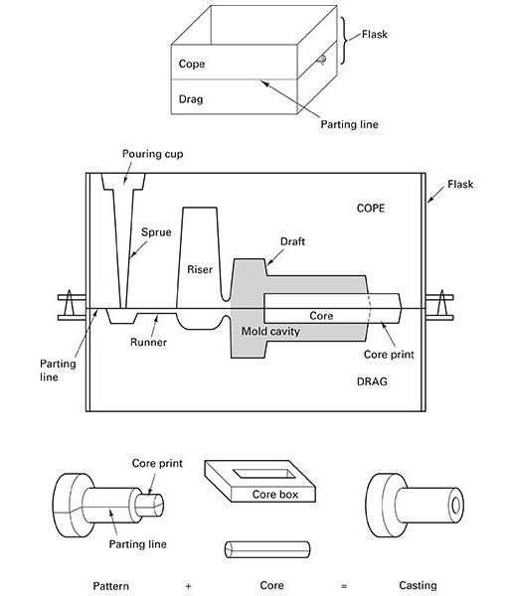
Two-part sand mold

Slide 6
Solidification Stages
Nucleation
Begins at mold walls
Each nucleation site produces a grain
Introduction of impurities promotes fine grains
Grain growth
Growth of nucleated grains
Control direction to assure solid casting
Smallest grains at casting wall

Slide 7
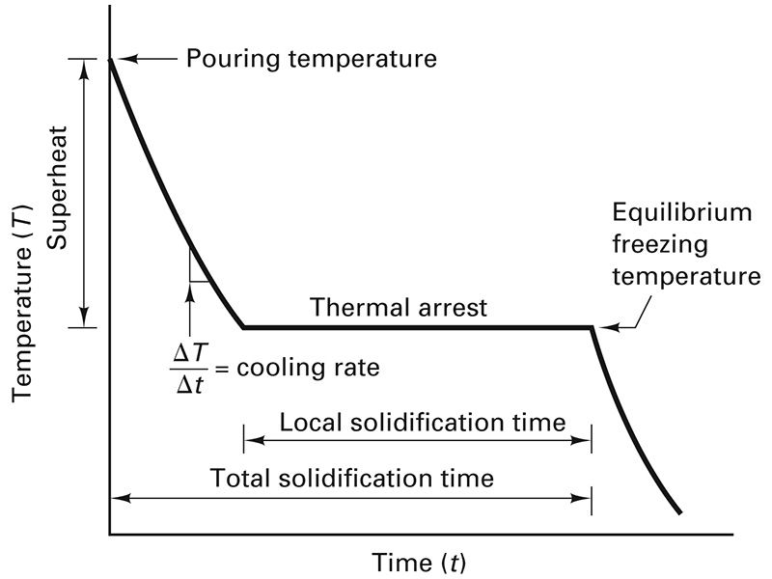
Metal cooling curve eutectic composition

Slide 8
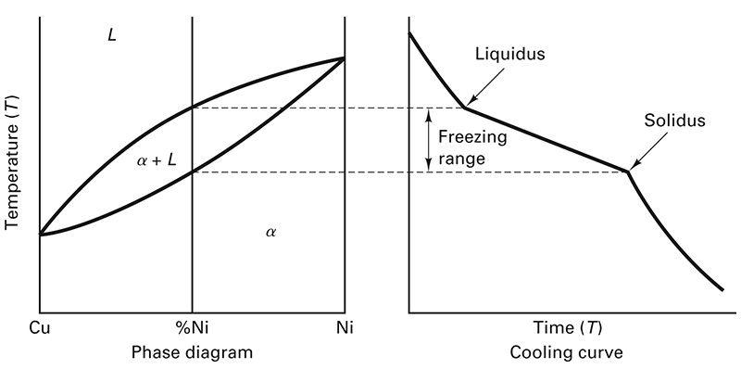
Phase Diagram and Cooling Curve Cu-Ni

Slide 9
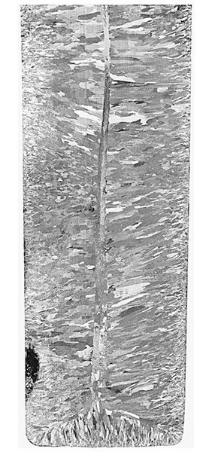
Internal structure of cast metal bar

Slide 10
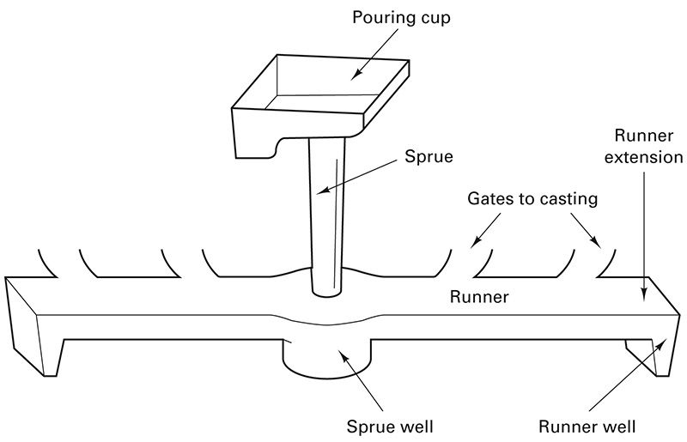
Gating system for sand mold

Slide 11
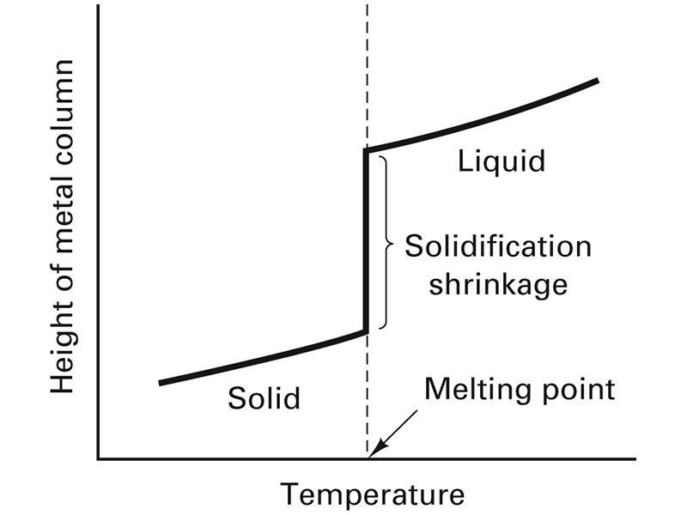
Dimensional changes of metal column

Slide 12
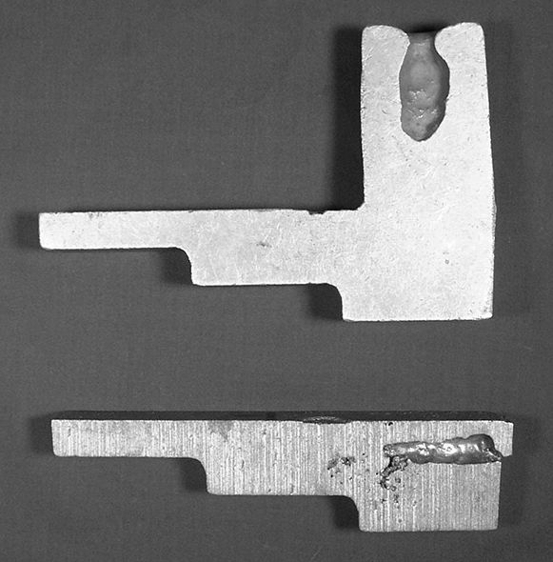
Shrinkage shift to riser

Slide 13
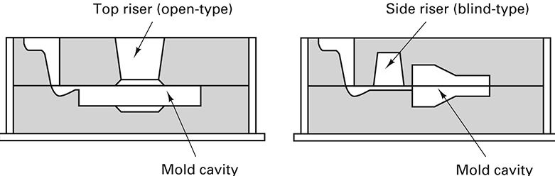
Riser types

Slide 14
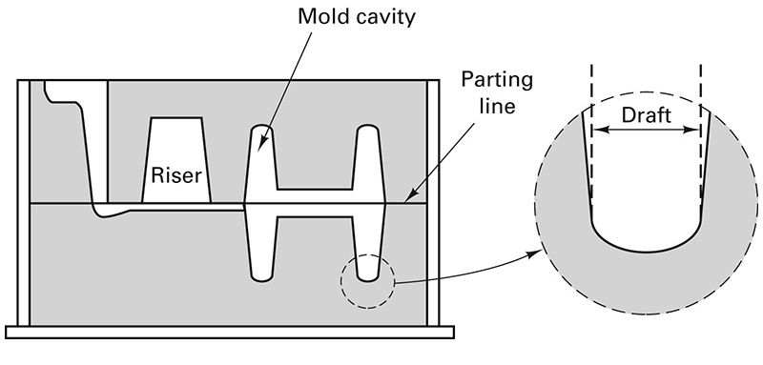
Draft allowance

Slide 15
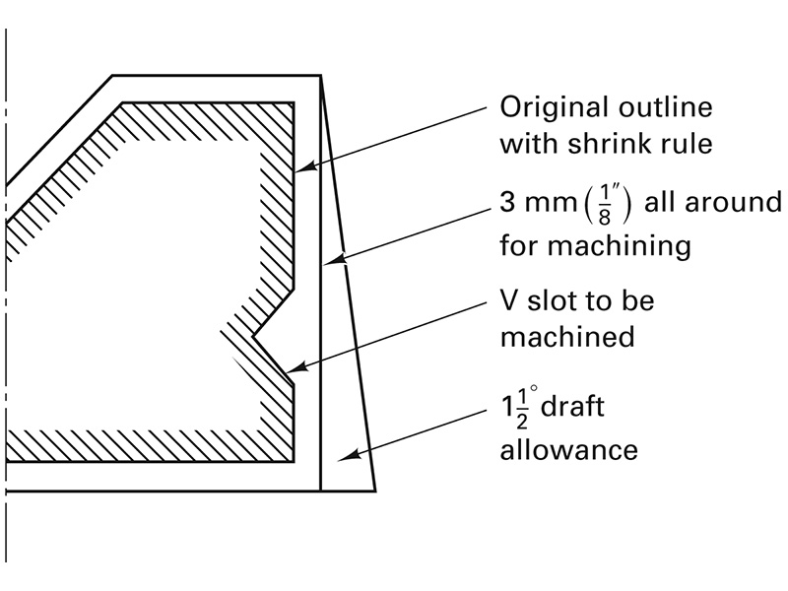
Machining Allowance

Slide 16
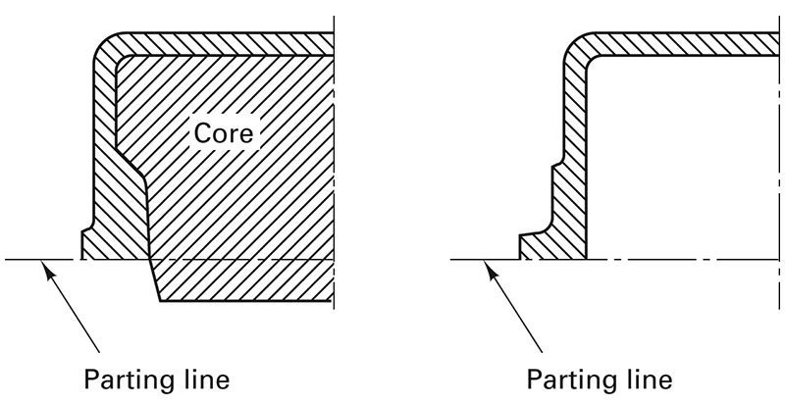
Eliminate Dry-sand Core

Slide 17
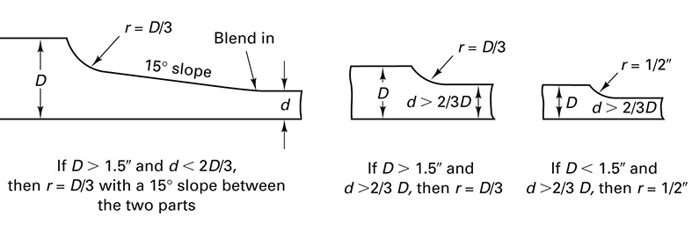
Section Change Transition

Slide 18
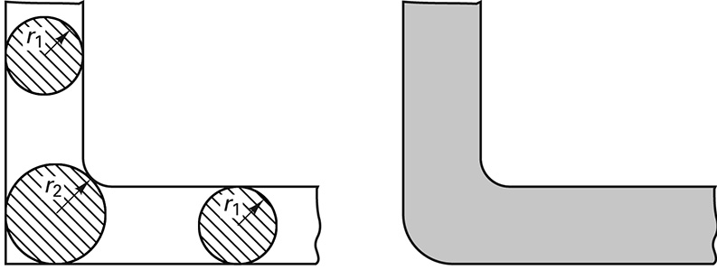
Hot Spots

Slide 19
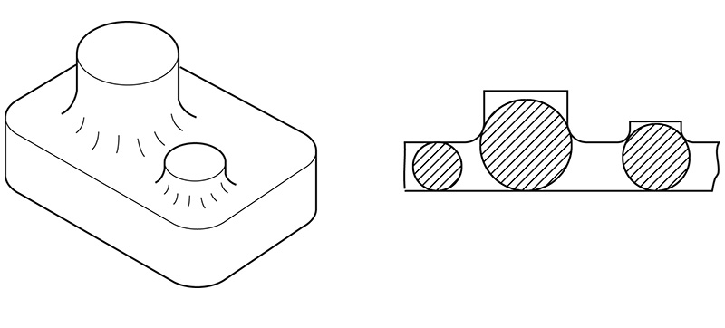
Intersecting section hot spots

Slide 20
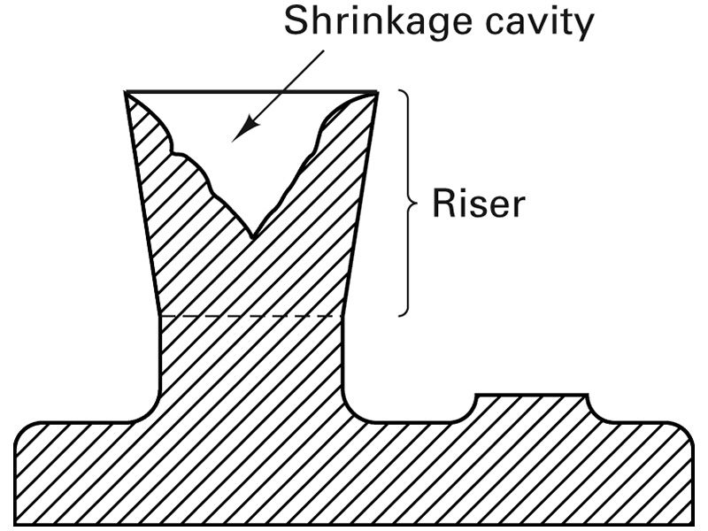
Attached Riser

